Slide 1

Hello!
I am Chinthaka Jayaweera
chinthaka0531@gmail.com
+94702519585

Slide 2
License plate recognition with YOLO V5

Slide 3
1.
Methodology

Slide 4
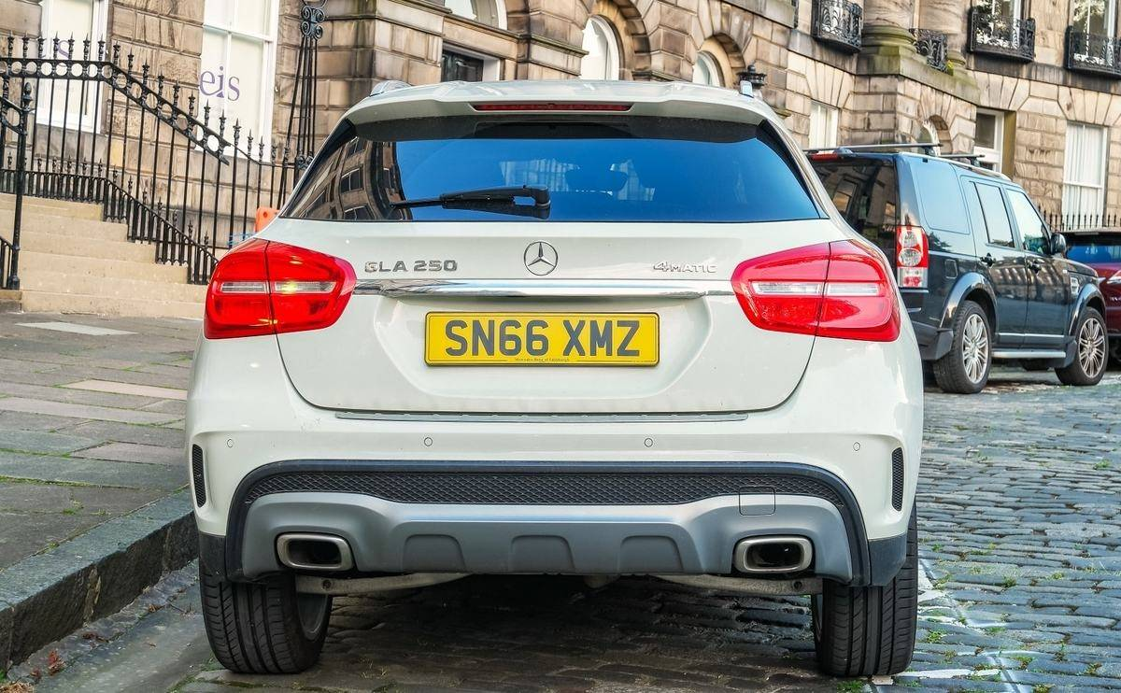
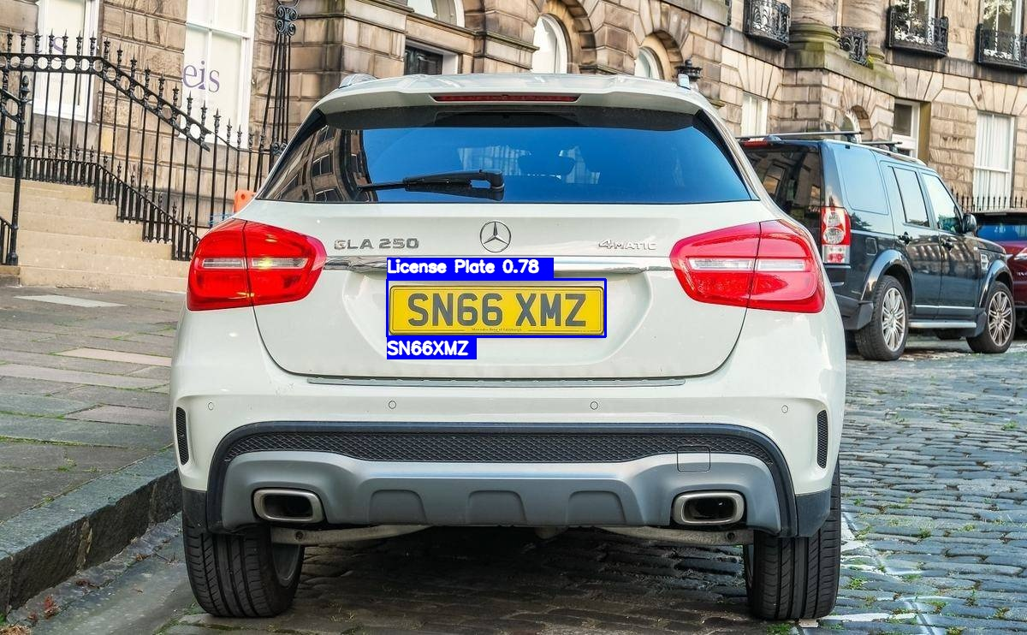
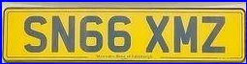
Input Image
Detected Number Plate
Number recognition
A cropped vehicle
Detected and cropped the number plate using trained Yolo
Used EasyOCR to recognize the text in the plate
Figure 01: Input image
Figure 02: Cropped license plate
Figure 03: Output

Slide 5
Dataset
Kaggle Car license plate detection dataset was used
Annotation format: Pascal VOC
Number of samples: 433
Training samples: 283
Validation samples: 100
Testing samples: 50

Slide 6
Object detection model
Yolo V5 was used as the detection model
There are 10 versions of pre-trained checkpoints in their work
Yolov5s version was used in the project
Since the dataset is too small training was started from pre-trained weights
Repo link

Slide 7
2.
Results

Slide 8
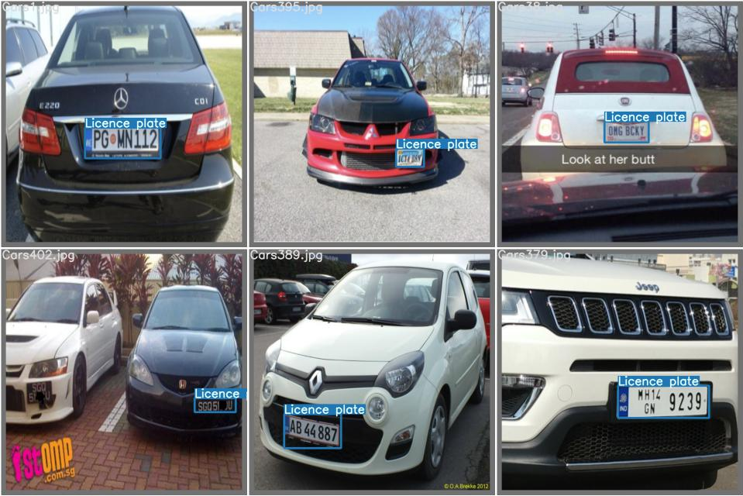
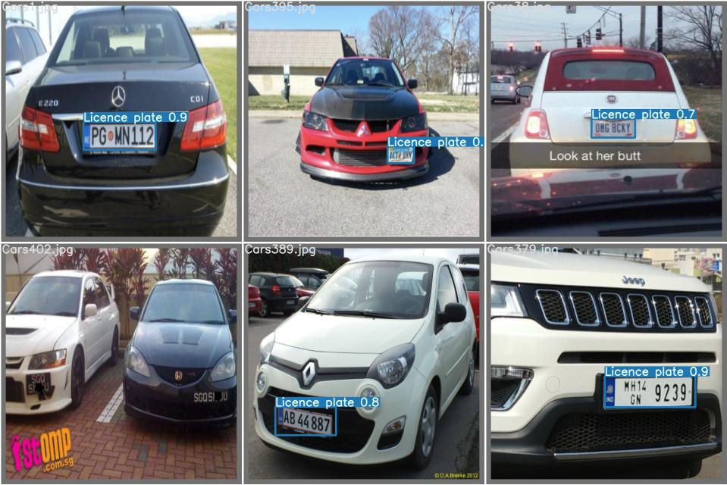
Plate detection results
Figure 05: Ground Truth
Figure 06: Predictions

Slide 9
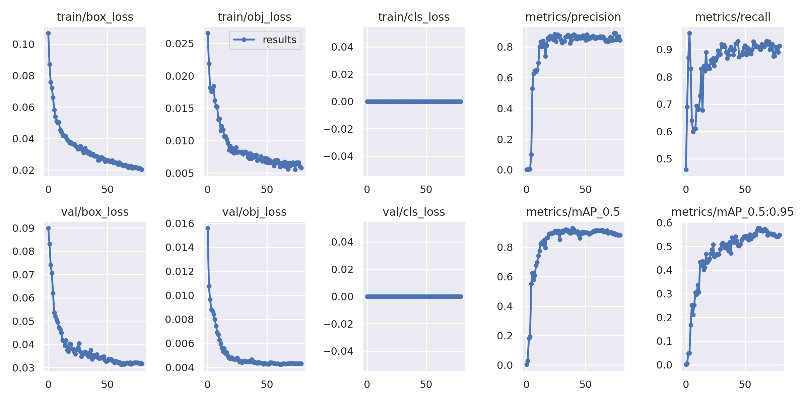
Plate detection results
Figure 07: Training results

Slide 10
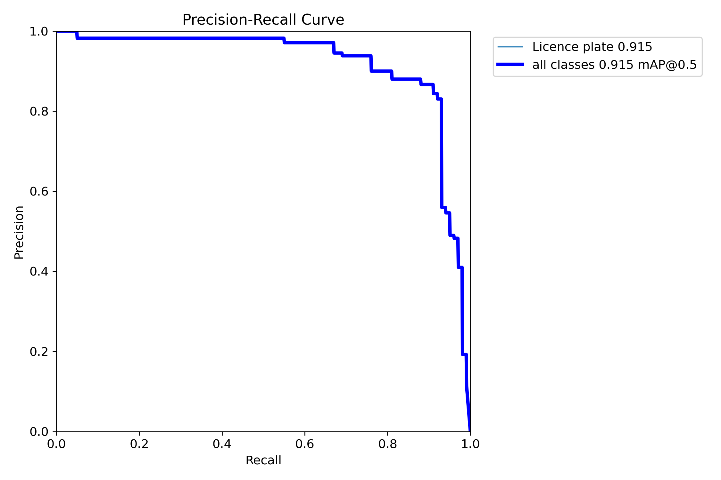
Plate detection results
mAP at 0.5 IOU = 0.915
mAP@0.5:0.95 IOU = 0.578
Figure 08: Precision_Recall Curve

Slide 11
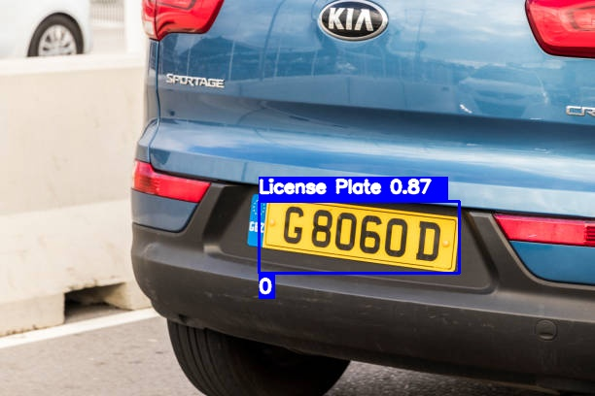
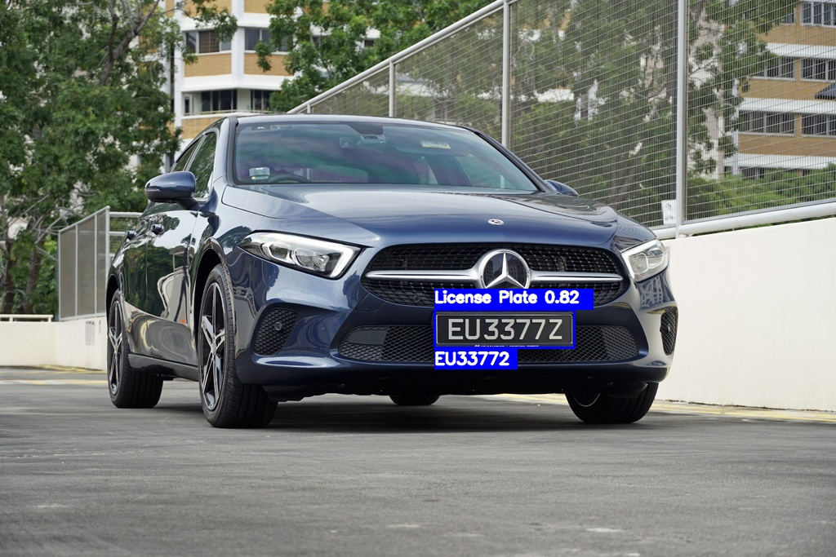
Final Results with OCR
Figure 09: Final results with OCR

Slide 12
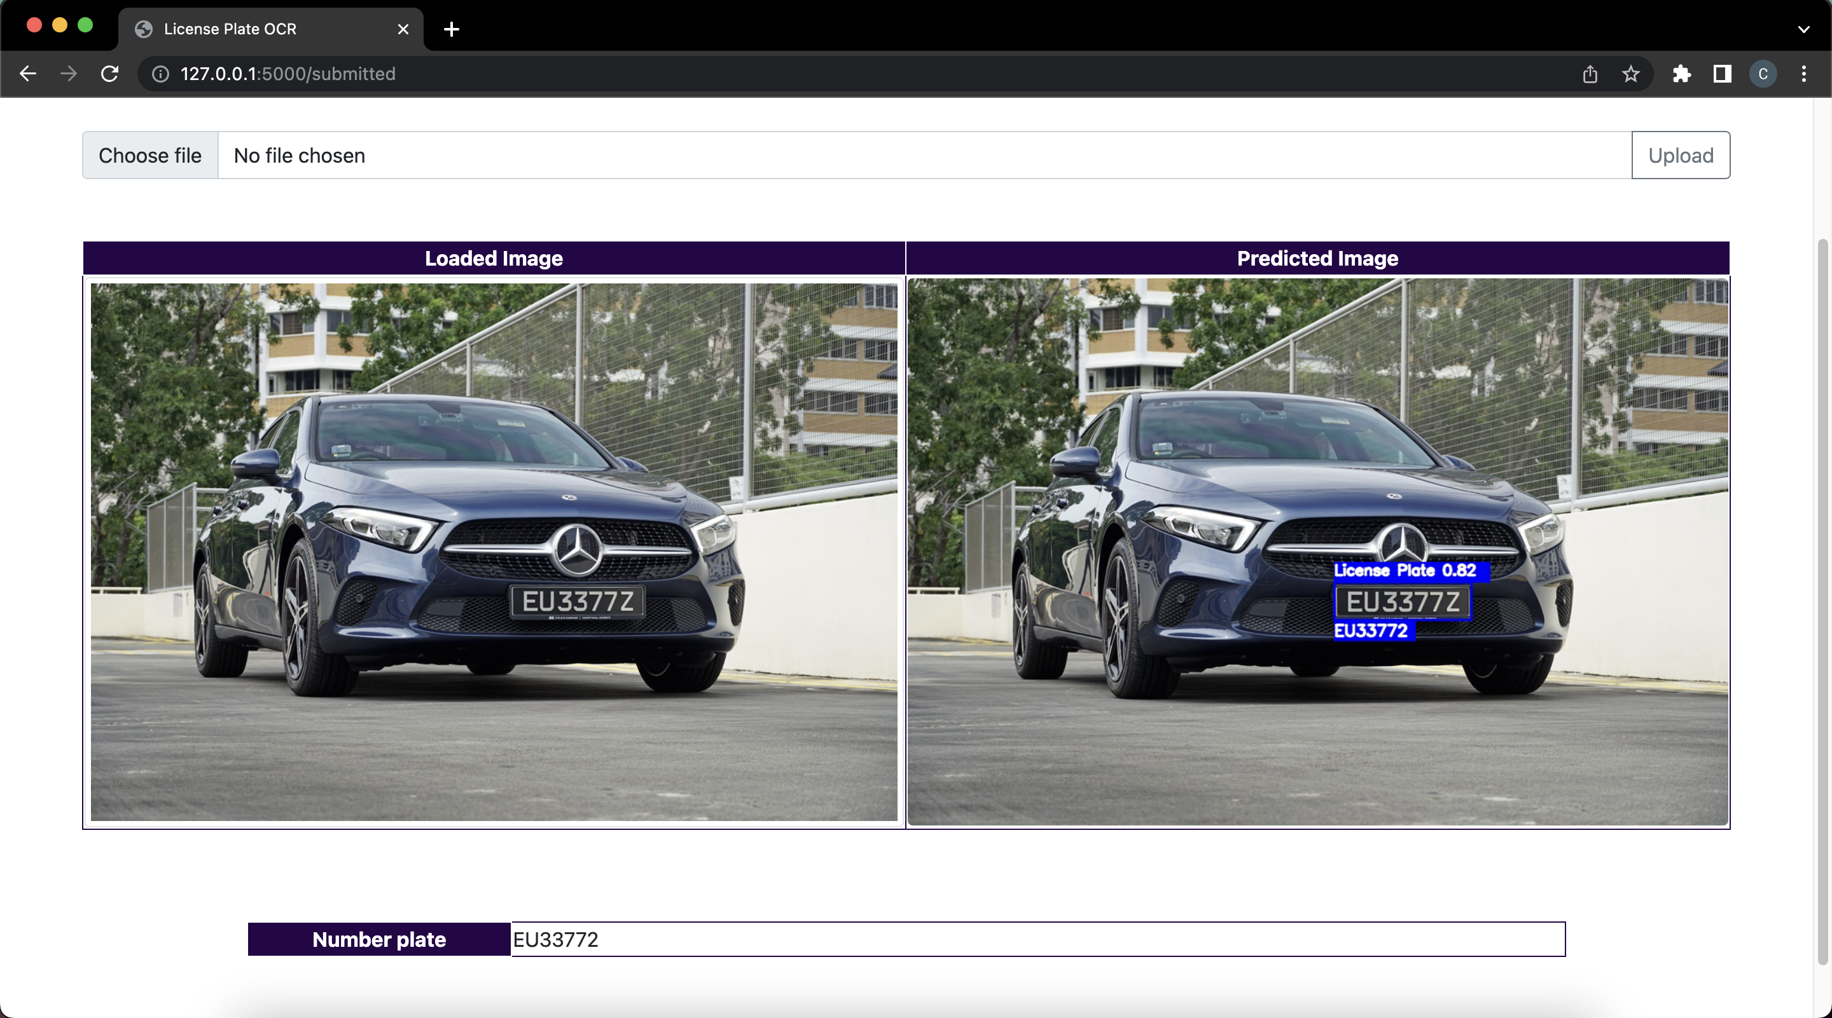
Final product
Figure 10: Final product as a web application

Slide 13
3.
CHALLENGES

Slide 14
Challenges | Possible Solutions
Small dataset | Start training from pre-trained weights Collecting more data Data augmentation
Low OCR accuracy in tilted License plates | Using perspective transformation techniques
When there are multiple vehicles in an image? | Training the model with a proper dataset First, detect vehicles using a vehicle detector and then do license plate detection
Table 01: Challenges and solutions

Slide 15
Thanks!
Any questions?

